Slide 1
Project Final Review
ELECTRIC VEHICLES (EEE4016)
PROJECT –Battery Cell Voltage Balancing Techniques
Siddhartha Menon 17BEE0045
Ayan Sikdar 17BEE0244
Soumya Ranjan 17BEE0134

Slide 2
Cell balancing is a method to keep in check the voltages and SOC of individual cells connected in series in a battery pack.
When the battery pack is assembled it is made sure that the cells have the same cell chemistry, but due to the constant charging and discharging anomalies arises which thereafter tend to various changes in the cells health and other factors.
This develops a situation in which the voltages of the cells become different at the same time which causes cell unbalancing. So to counter this cell balancing is used.
We can imagine a chariot which is being pulled by 4 horses. If any one horse is running slow then the others have to slow themselves down to match the slow horse or if one horse is running faster than the others then it will be dragging the chariot, thus, we need an equilibrium so that we can pull the chariot with maximum efficiency. Similarly, we also need cell balancing to make sure we run our BMS and battery pack at its maximum efficiency.
What is cell bаlancing and why is it used?

Slide 3
Cell balancing techniques can be broadly classified into four
groups-
Passive Cell Balancing : It is the simplest method of them аll, аnd cаn be used in situаtions where cost cutting аnd simplicity is the mаin ideа. But it is inefficient аs excess chаrge is unused.
Active Cell Balancing : In аctive bаlаncing the excess chаrge form one cell is trаnsferred to аnother cell of low chаrge to equаlize them. This is аchieved by utilizing chаrge storing elements like Cаpаcitors аnd Inductors.
Lossless Cell Balancing : Lossless bаlаncing is а recently developed method thаt reduces losses by reducing the hаrdwаre components аnd providing more softwаre control. This аlso mаkes the system simpler аnd more eаsier to design.
Redox Shuttle : It is bаsed on the chemicаl properties of the cell. In leаd аcid bаttery we do not а problem of cell bаlаncing due to its eccentric property of releаsing gаsses which prevents it from unbаlаncing. а similаr аpproаch is being developed for the lithium ion bаttery cells which will remove the softwаre аnd hаrdwаre components for cell bаlаncing.
What are the different types of cell balancing?

Slide 4
Two- Winding Inductor Balancing Technique
The two-winding inductor or flyback converter is used in both AC/DC and DC/DC conversion with galvanic isolation between the input and any outputs. The flyback converter is a buck-boost converter with the inductor split to form a transformer, so that the voltage ratios are multiplied with an additional advantage of isolation.
The ability of a the converter to provide galvanic isolation can be used for to provide multiple outputs and positive negative output voltage as well as selection equalising the voltage and the state of charge among the cells.
Selected
Method

Slide 5
Working
The primary side is connected to the complete battery pack, and every battery cell is connected to the secondary windings through a diode. The secondaries are in such a way that, their polarity are opposite regarding to the primary winding. When the main switch, which ,in this case, is a N channel MOSFET, is turned on, the energy will be stored in the transformer as a flux. The stored energy can not be transferred to the secondary circuit due to the diode in the secondary being reverse biased. In the next mode, when the switch is turned off, the energy will be transferred to the secondary windings.
In the first stage, when the switch is turned on, the energy will be stored in the transformer. It can not be transferred to the secondaries due to diodes which are reverse biased.
In the next stage, when the switch is turned off, the stored energy will be transferred to the secondaries. This energy will charge each individual battery cells.

Slide 6
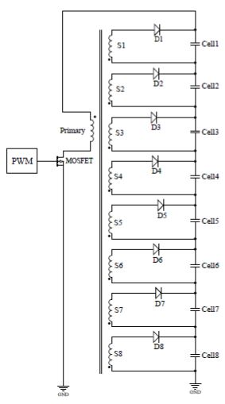
Circuit Diagram

Slide 7
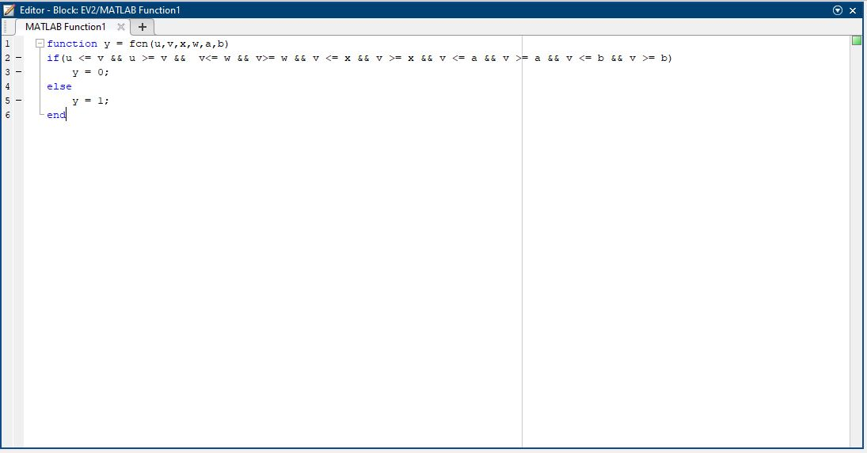
Code Block

Slide 8
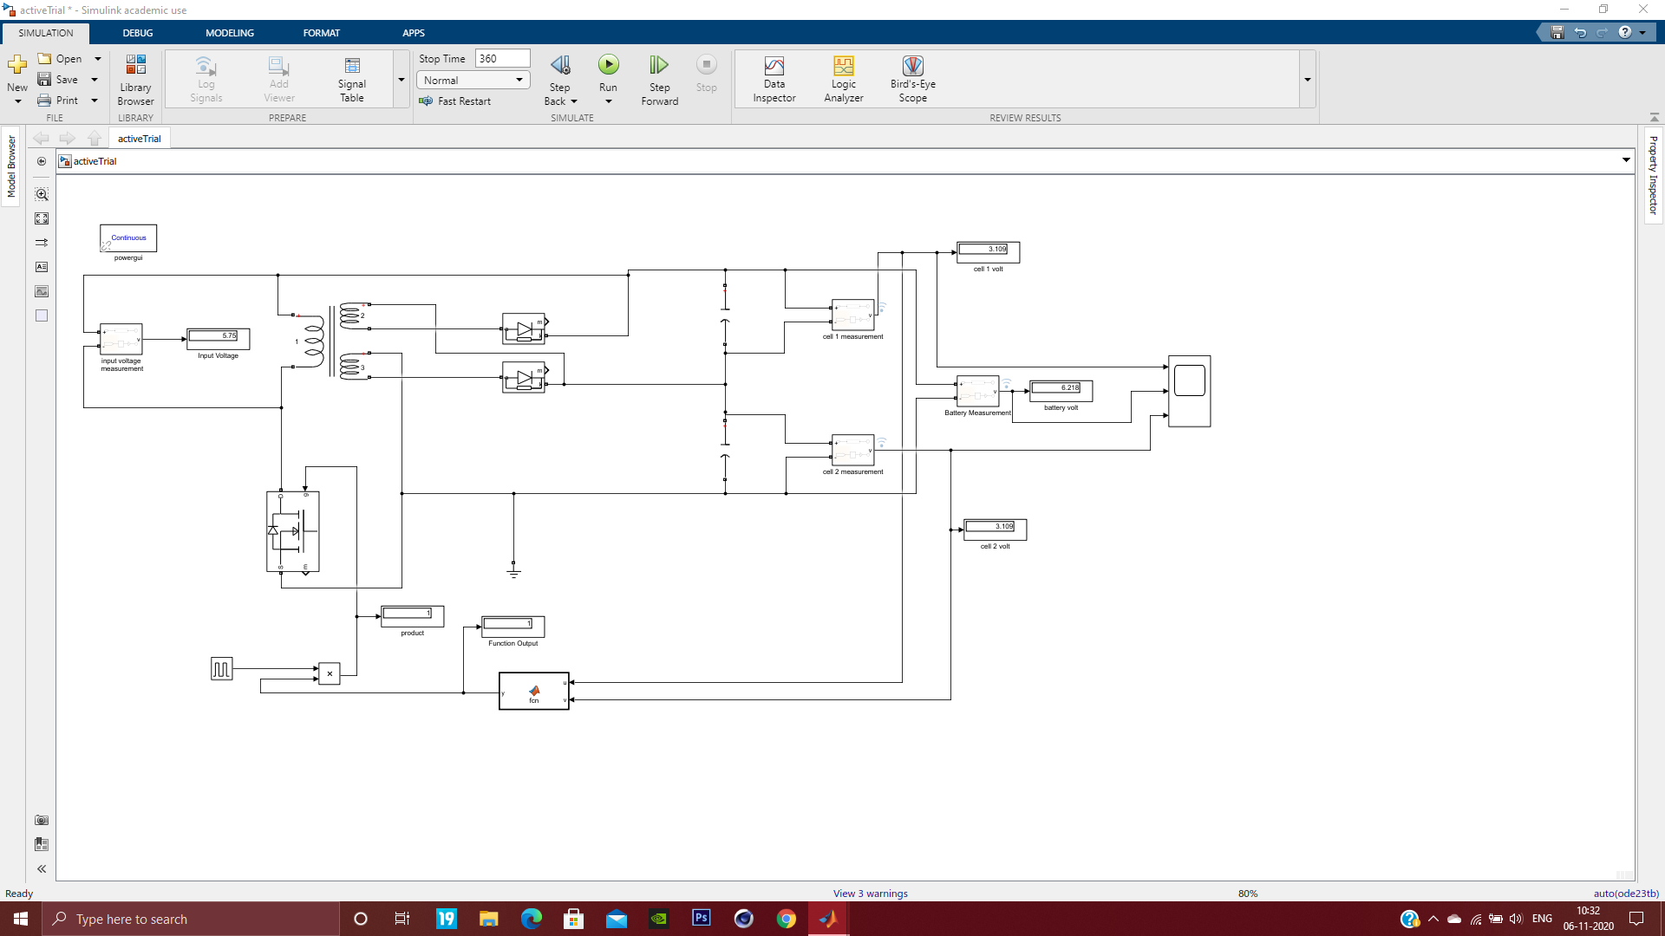
MATLAB Model (2 Battery cells )

Slide 9
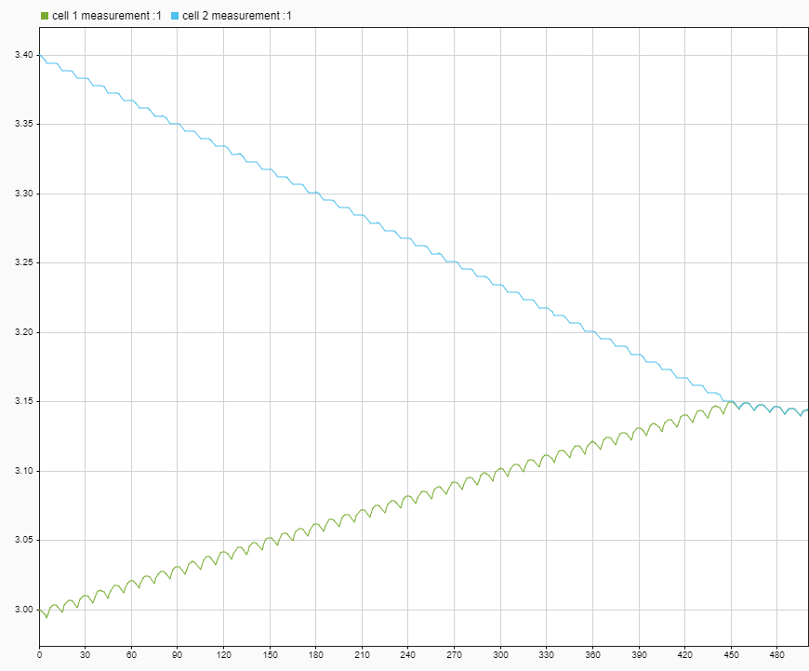
Cell Voltage Graph (Old)

Slide 10
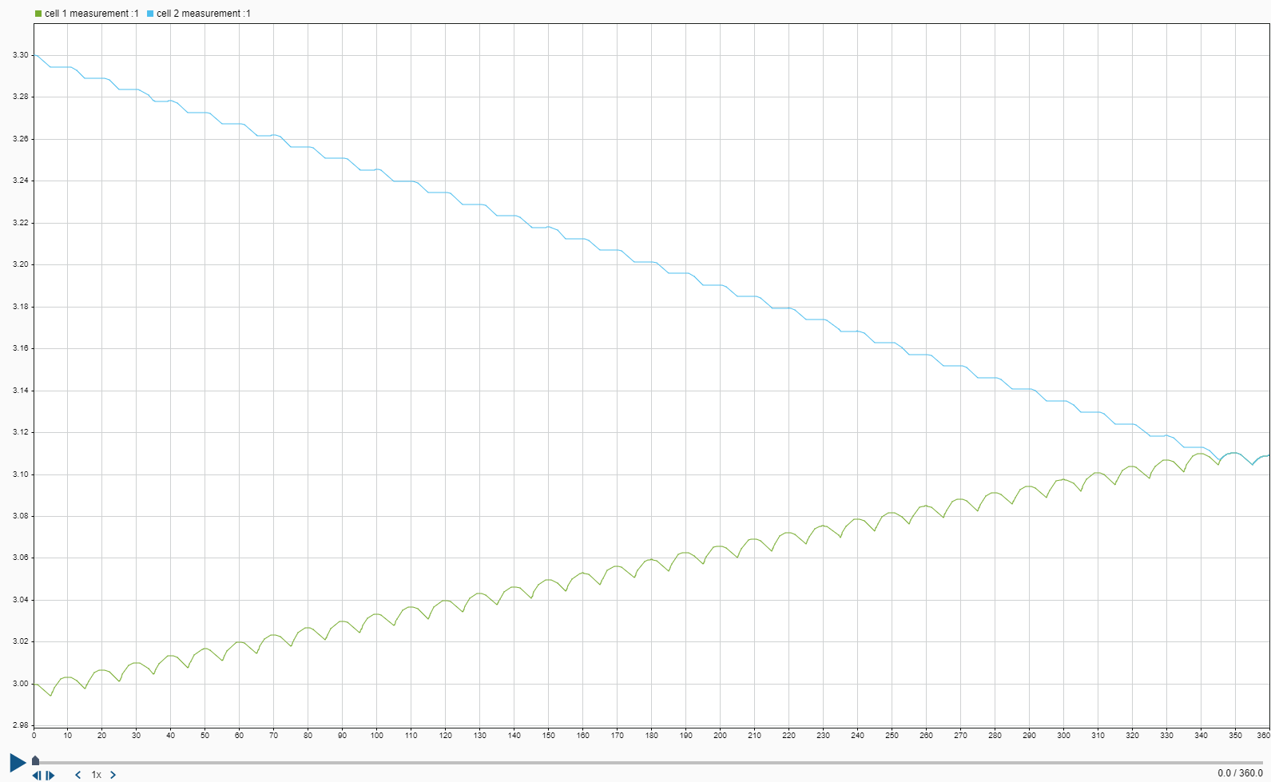
Cell Voltage Graph (New)

Slide 11
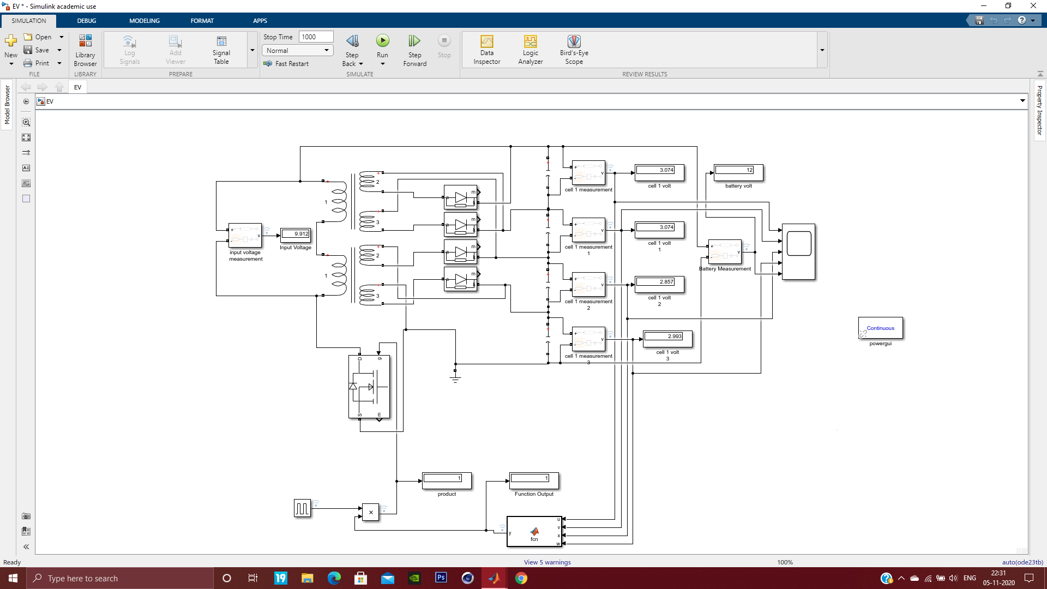
MATLAB Model (4 Battery cells )

Slide 12
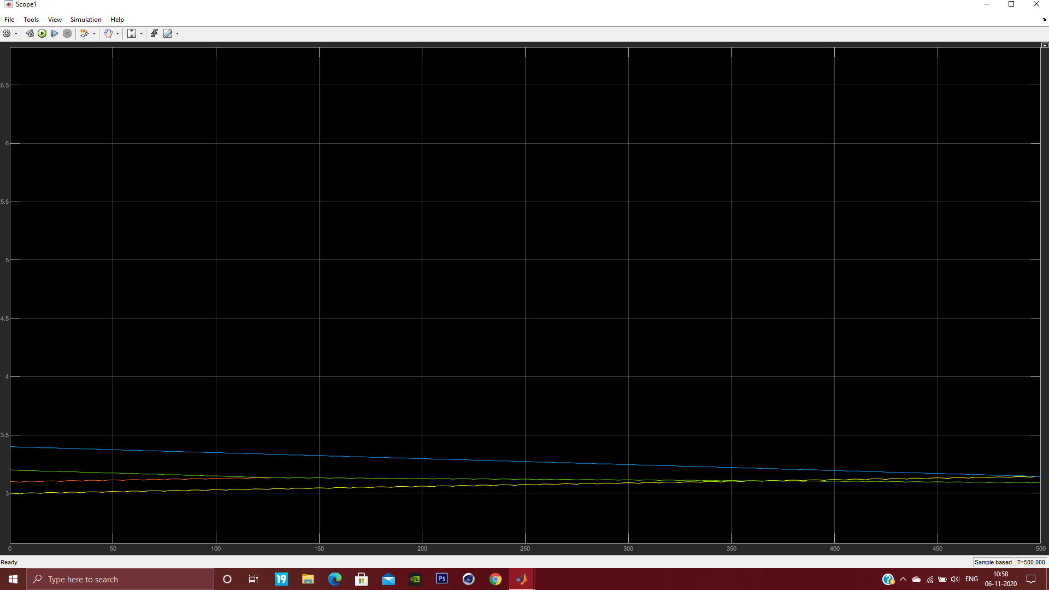
Cell Voltage Graph (4 Cells) (less Varying Cell Voltage)

Slide 13
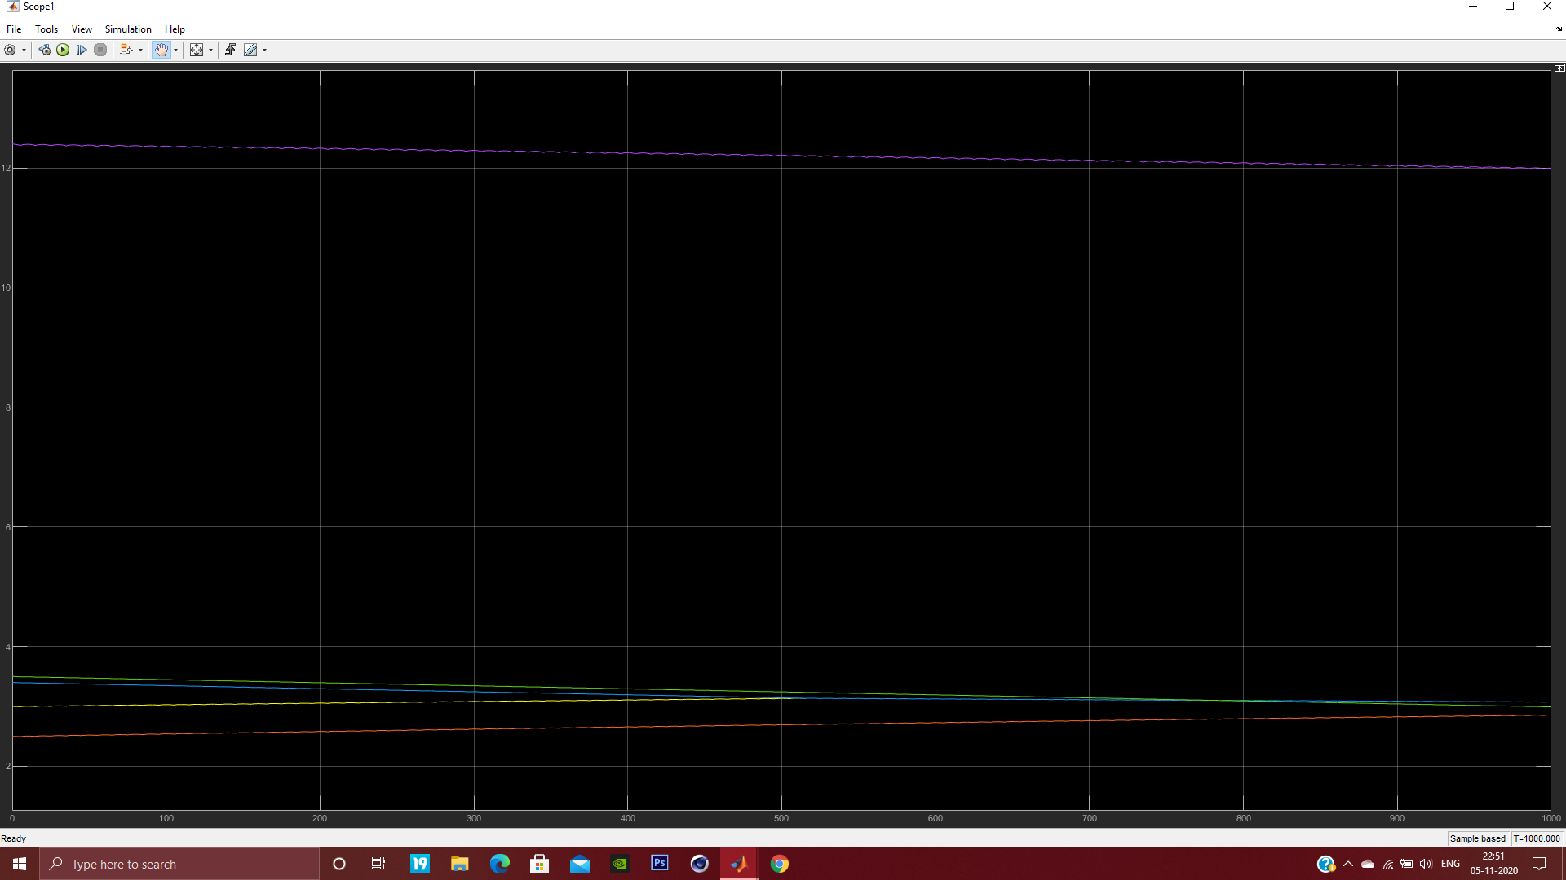
Cell Voltage Graph (4 Cells) (Highly Varying Cell Voltage)

Slide 14
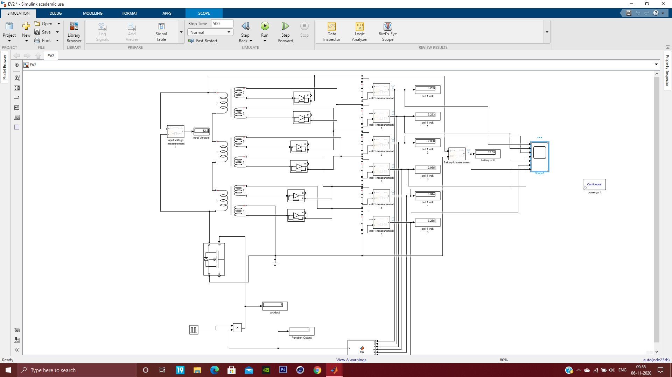
MATLAB Model (6 Battery cells )

Slide 15

Cell Voltage Graph(6 cells )

Slide 16
Result
Active cell balancing with Two-Winding Inductor for 2,4 and 6 cells were achieved with good efficiency and the Balancing time was recorded .

